Slide 1

Impact of Autologous Transplantation vs Chemotherapy Plus Lenolidomide in Newly Diagnosed Myeloma According to Patient Prognosis: Results of a Pooled Analysis of Two Phase II Trials
Abstract 198
Gay F, Cerrato C, Hajek R, Di Raimondo F, Caravita T, Falcone AP, Patriarca F, Pulini S, Finsinger P, Ciccone G, Corradini P, Siniscalchi A, Donato F, Ben Yahuda D, Offidani M, Minarik J, Ria R, Cavallo F, Catalano L, Cavalli M, Pour L, Petrucci MT, Hardan I, Boccadoro M, Spencer A, Palumbo A

Slide 2

Rationale
ASCT vs Conventional Chemotherapy + Novel Agents
MPT vs Mel100-ASCT1
Age 65-75 years
MPR vs Mel200-ASCT²
Age ≤65 years
1.0 –
0.8 –
0.6 –
0.4 –
0.2 –
0.0 –
Treatment
MP
MPT
MEL1000
O/N
128/196
62/125
78/126
OS
Time, Months
(Median SE)
33.2 (3.2)
51.6 (4.5)
38.3 (2.7)
High-dose melphalan
MPR
100 –
75 –
50 –
25 –
0 –
Proportion of Surviving Patients
Probability of 4-Year Overall Survival
0 12 24 36 48 60 72 84
0 6 12 18 24 30 36 42 48 54 60
Time From Randomization, Months
Months
Number at risk
MP 196 170 153 136 111 85 67 49 30 24 13 10 6
MPT 125 117 109 104 90 78 58 47 38 26 16 9 3
MEL100 126 103 96 92 76 62 50 36 29 19 12 6 4
141 136 129 121 115 111 105 88 42 7
132 131 124 121 117 106 94 82 27 5
MPT vs Mel 100-ASCT: HR 0.59, P = .0006
MPT200-ASCT vs MPR: HR 0.55, P = .02
MP, melphalan-prednisone; MPT, MP plus thalidomide; ASCT, autologous stem-cell transplantation; Mel100, melphalan 100 mg/m²; MPR, melphalan-prednisone-lenalidomide
1. Facon T, et al. Lancet. 2007;370(9594):1209-1218.
2. Palumbo A, et al. N Engl J Med. 2014;371(10):895-905.
Gay F, et al. Blood. 2014;124: Abstract 198.

Slide 3
Aims
To compare Mel200-ASCT vs CC+R in a large population of patients ≤65 years
PFS1
PFS2
OS
To evaluate the role of ASCT as salvage therapy at first relapse
To compare Mel200-ASCT vs CC+R in subgroups of patients with different prognosis
Is there a subset of patients who may benefit from a less intensive oral therapy upfront, and transplant at first relapse?
Gay F, et al. Blood. 2014;124: Abstract 198.

Slide 4
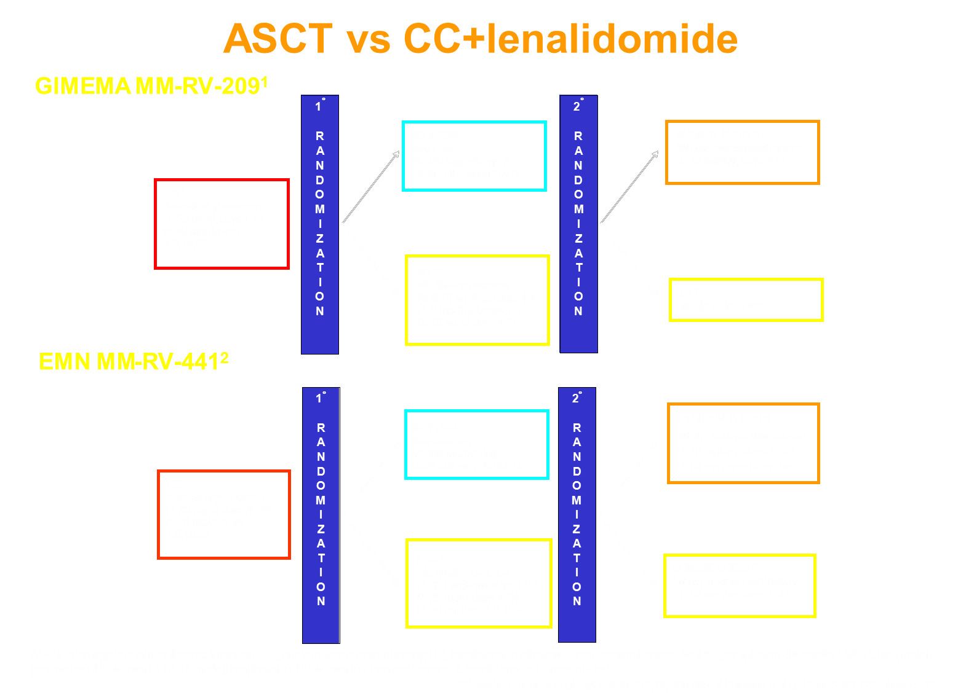
ASCT vs CC+Lenolidomide
1. Palumbo A, et al. N Engl J Med. 2014;371(10):895-905; 2. Palumbo A, et al. Blood. 2013;122: Abstract 763.
Gay F, et al. Blood. 2014;124: Abstract 198.

Slide 5
ASCT vs CC+Lenolidomide
1. Palumbo A, et al. N Engl J Med. 2014;371(10):895-905; 2. Palumbo A, et al. Blood. 2013;122: Abstract 763.
Gay F, et al. Blood. 2014;124: Abstract 198.

Slide 6
ASCT vs CC+Lenolidomide
Recommended ASCT at first relapse
Recommended ASCT at first relapse
1. Palumbo A, et al. N Engl J Med. 2014;371(10):895-905; 2. Palumbo A, et al. Blood. 2013;122: Abstract 763.
Gay F, et al. Blood. 2014;124: Abstract 198.

Slide 7
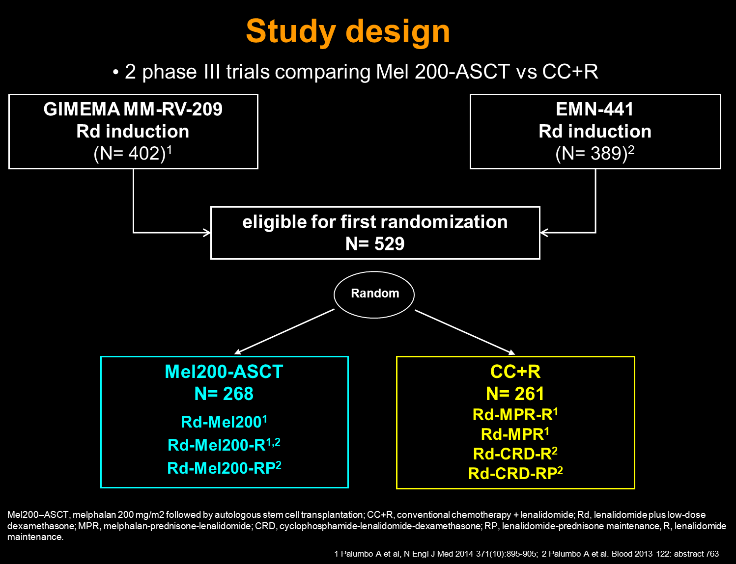
Study Design
Mel200, melphalan 200 mg/m² followed by autologous stem-cell transplantation; CC+R, conventional therapy + lenalidomide; Rd, lenalidomide plus low-dose dexamethasone; MPR, melphalan-prednisone-lenalidomide; CRD, cyclophosphamide-lenalidomide-dexamethasone; RP, lenalidomide-prednisone maintenance, R, lenalidomide maintenance.
1. Palumbo A, et al. N Engl J Med. 2014;371(10):895-905; 2. Palumbo A, et al. Blood. 2013;122: Abstract 763.
Gay F, et al. Blood. 2014;124: Abstract 198.

Slide 8
Patient Characteristics
 | Mel200-ASCT N = 268 | CC+R N = 261
Age, median (IQR) | 57 (52-62) | 57 (51-61)
Male sex | 52% | 51%
ISS stage
I | 52% | 47%
II | 33% | 33%
III | 15% | 20%
Cytogenetic Abnormalities Del 17 or t(4:14) or t(14:16) | 19% | 20%
Karnofsky performance score
60%-70% | 16% | 13%
80%-100% | 84% | 87%
LDH ≥ULN | 6% | 8%
Response to induction
≥VGPR | 26% | 31%
<VGPR | 74% | 69%
Gay F, et al. Blood. 2014;124: Abstract 198.

Slide 9
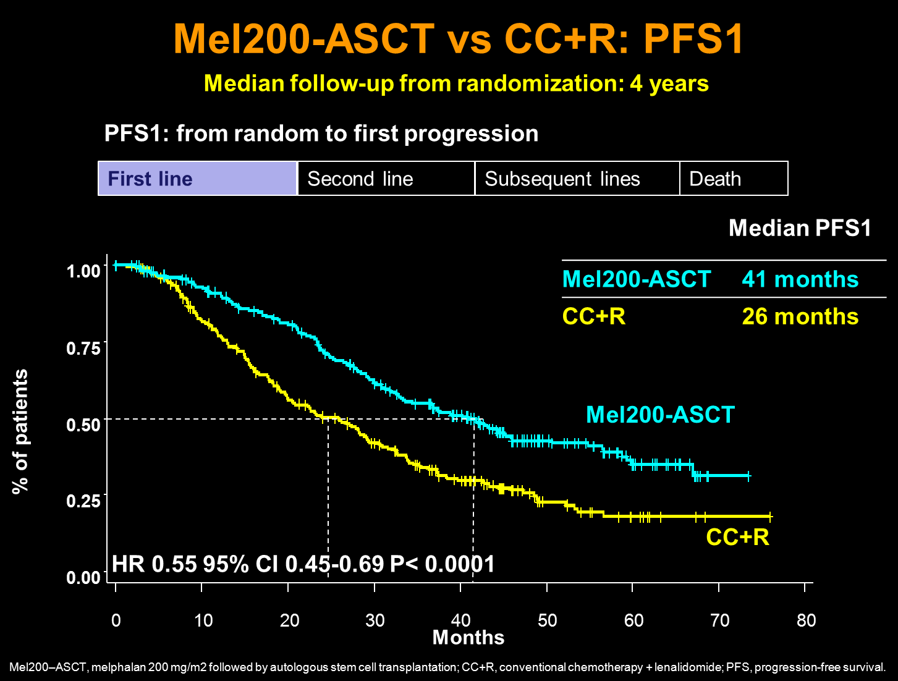
Mel200-ASCT vs CC+R: PFS1
Gay F, et al. Blood. 2014;124: Abstract 198.

Slide 10
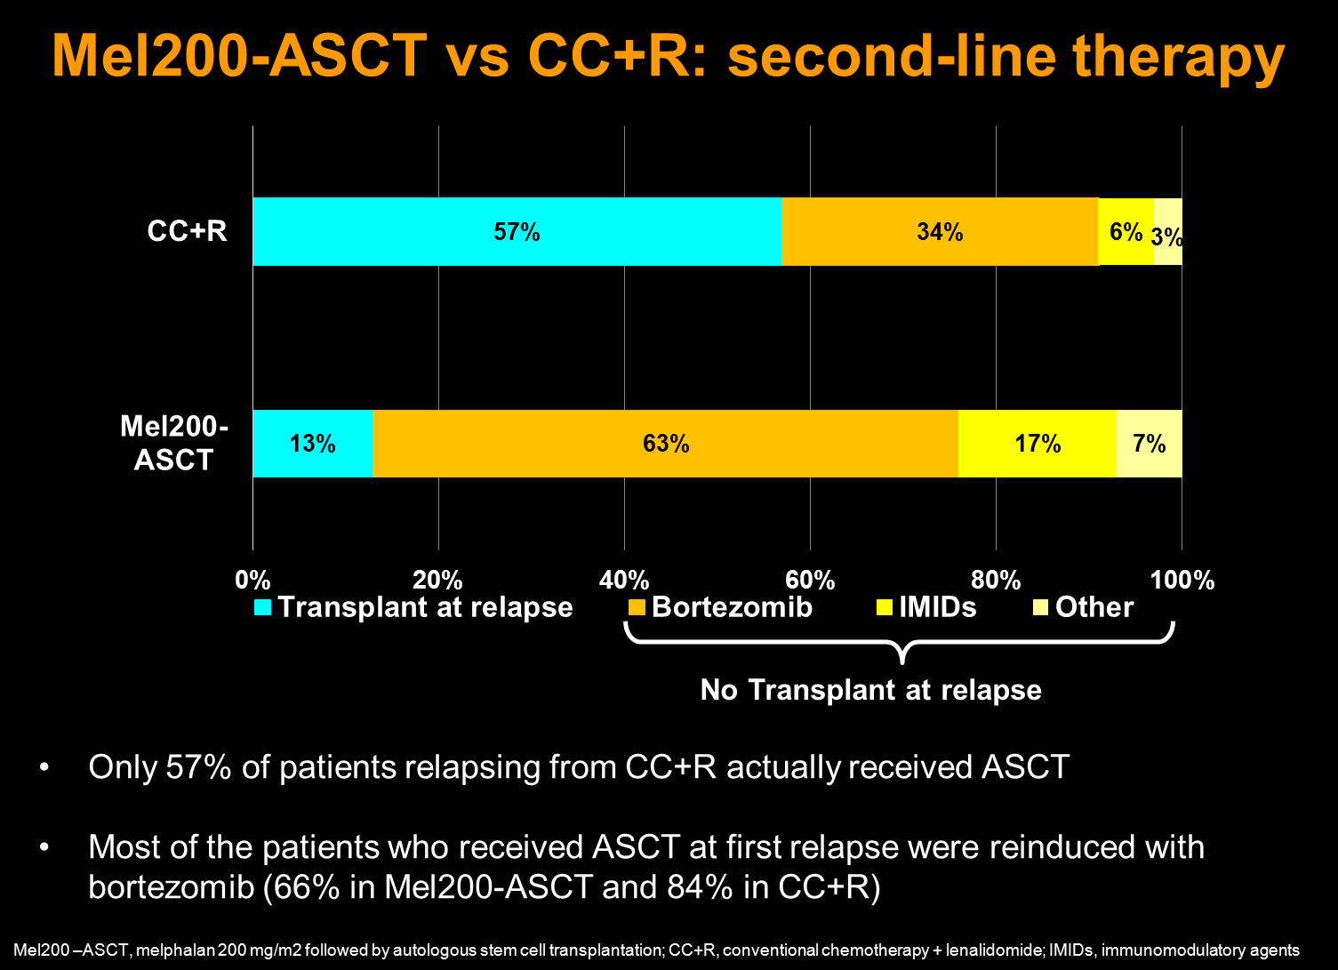
Mel200-ASCT vs CC+R: Second-Line Therapy
Gay F, et al. Blood. 2014;124: Abstract 198.
IMIDs, immunomodulatory agents

Slide 11
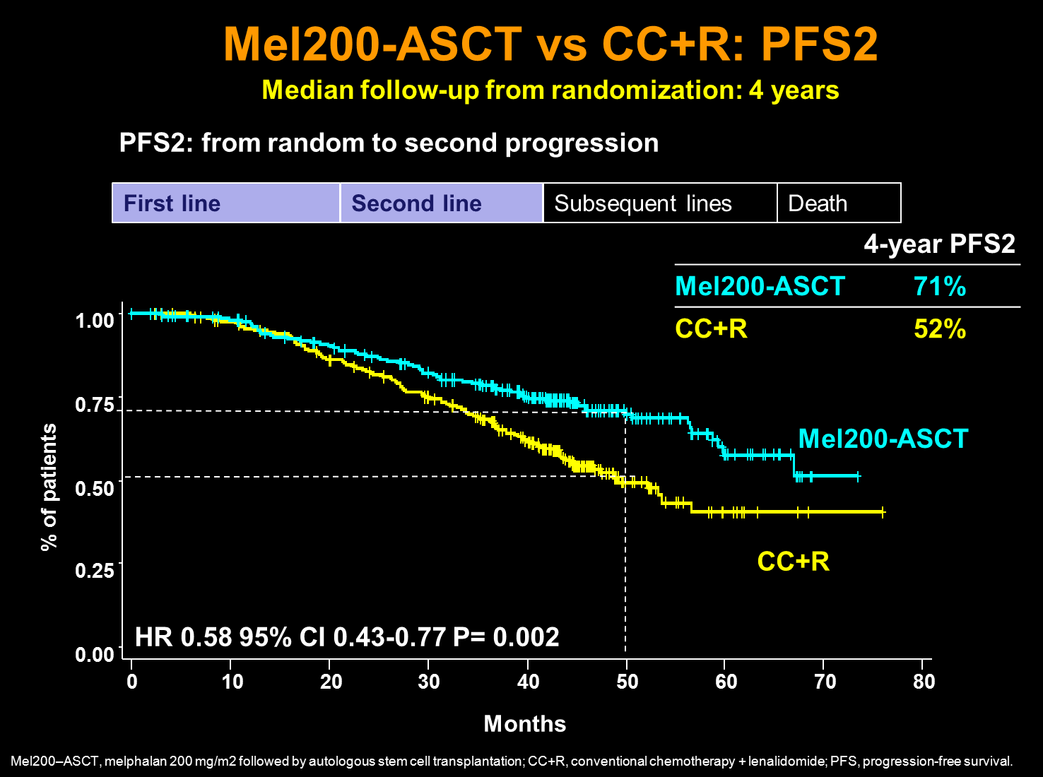
Mel200-ASCT vs CC+R: PFS2
Gay F, et al. Blood. 2014;124: Abstract 198.

Slide 12
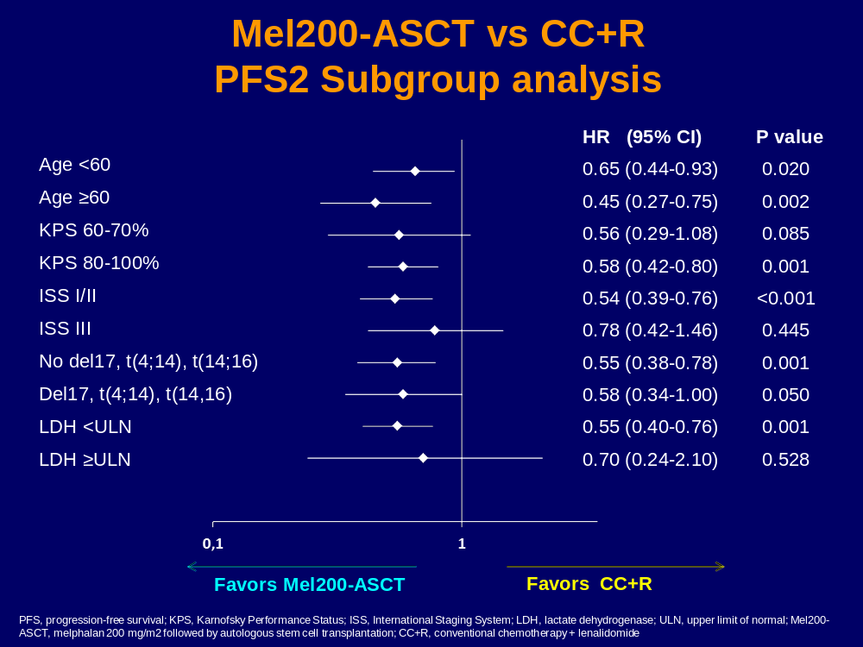
Mel200-ASCT vs CC+R:
PFS2 Subgroup Analysis
Gay F, et al. Blood. 2014;124: Abstract 198.

Slide 13
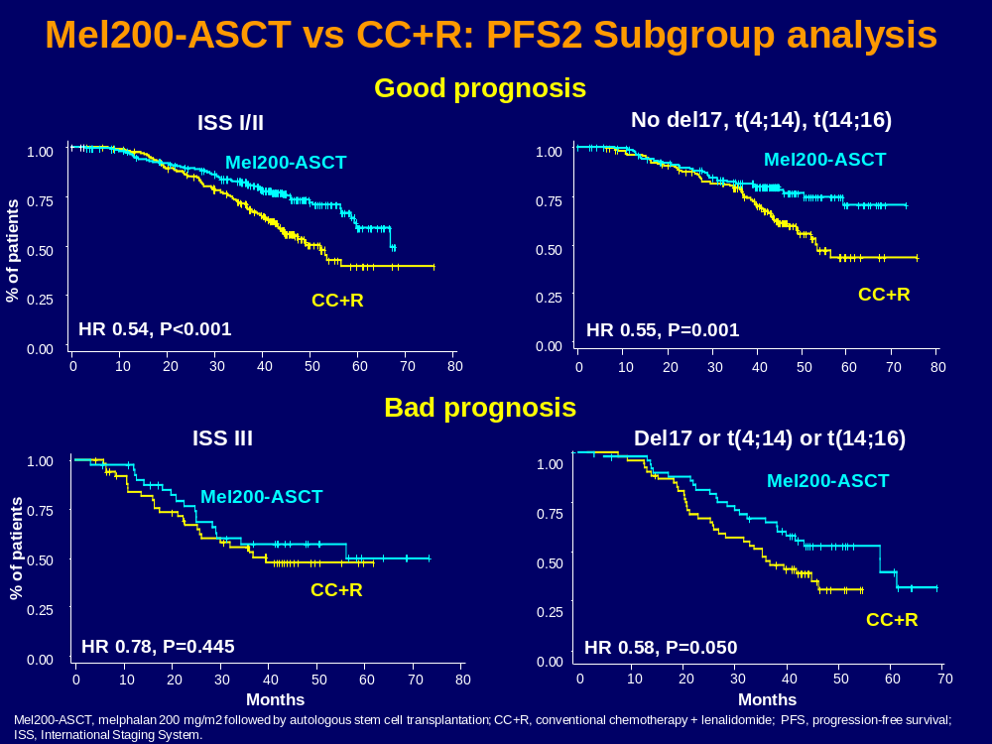
Mel200-ASCT vs CC+R: PFS2 Subgroup Analysis
Good Prognosis
Bad Prognosis
Gay F, et al. Blood. 2014;124: Abstract 198.

Slide 14
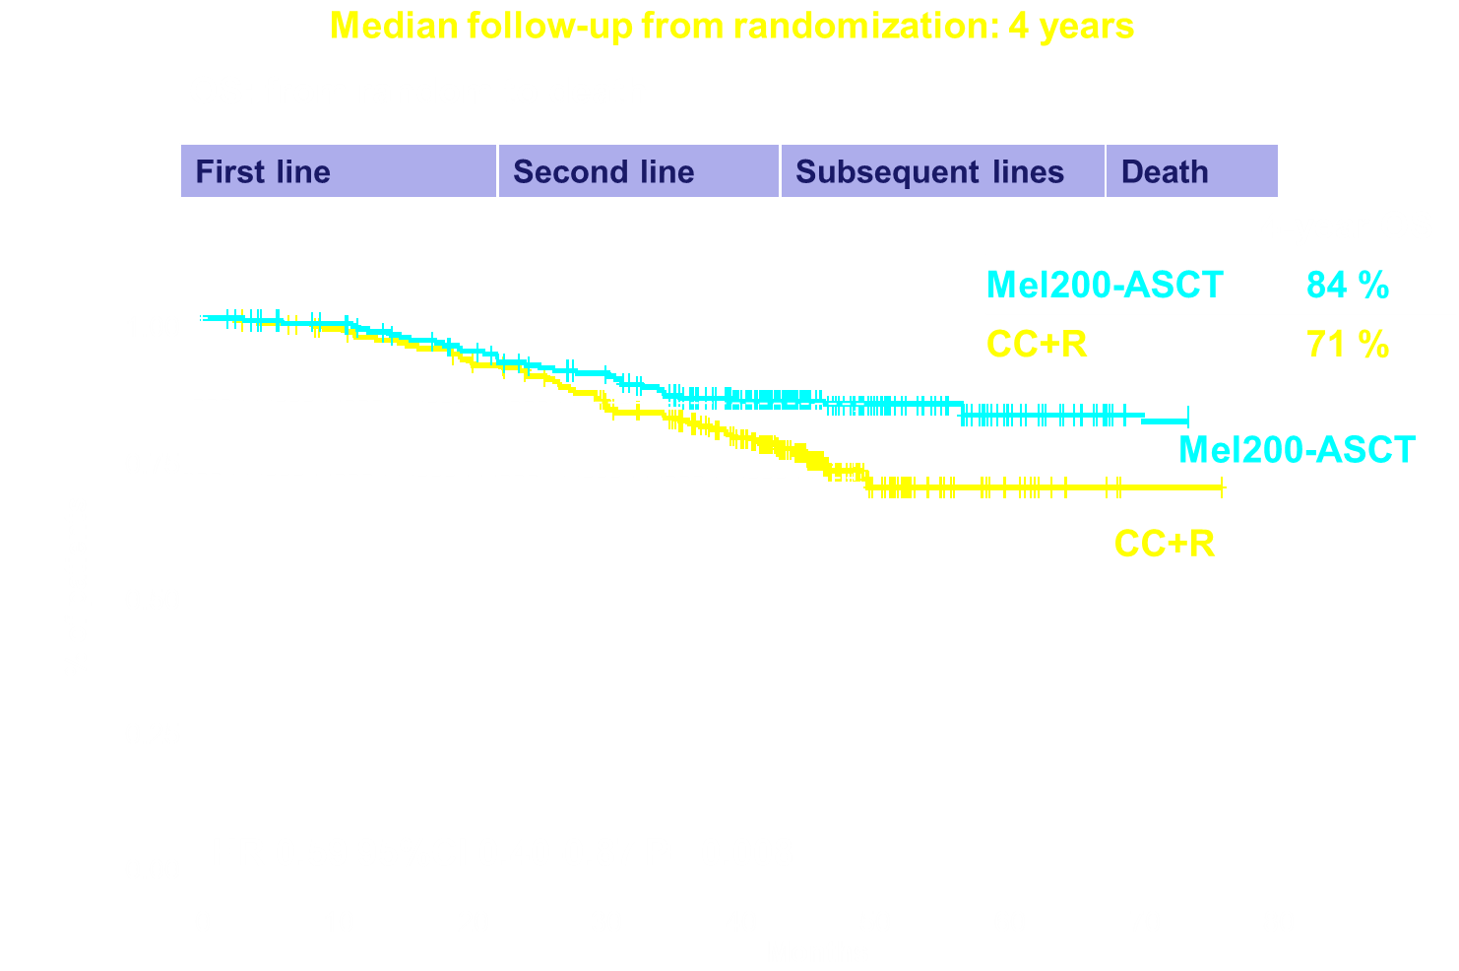
Mel200-ASCT vs CC+R: OS
Gay F, et al. Blood. 2014;124: Abstract 198.

Slide 15
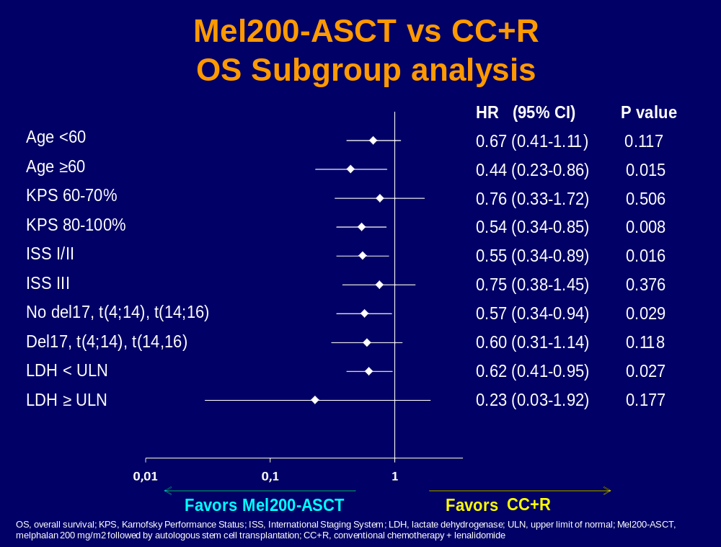
Mel200-ASCT vs CC+R:
OS Subgroup Analysis
Gay F, et al. Blood. 2014;124: Abstract 198.

Slide 16
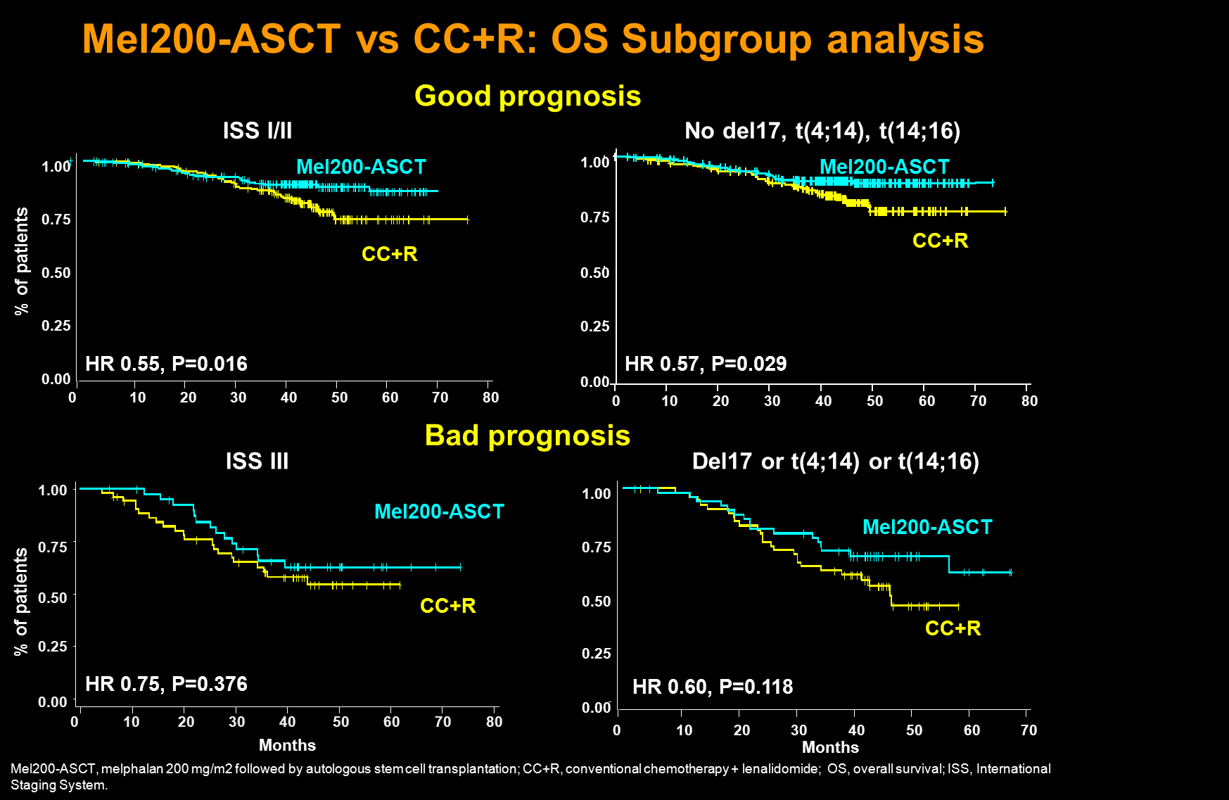
Mel200-ASCT vs CC+R: OS Subgroup Analysis
Gay F, et al. Blood. 2014;124: Abstract 198.

Slide 17
Conclusions
Mel200-ASCT vs CC+R significantly prolongs PFS1, PFS2, andd OS in comparison with CC+R
ASCT as salvage therapy may not be feasible in all patients
The major benefit of Mel200-ASCT vs CC+R was shown in patients with good prognosis
Intensified treatment to prolong OS
Bad prognosis patients require more effective treatment
Gay F, et al. Blood. 2014;124: Abstract 198.

